Slide 1
Data Transmission
Why we need Data Transmission?

Slide 2
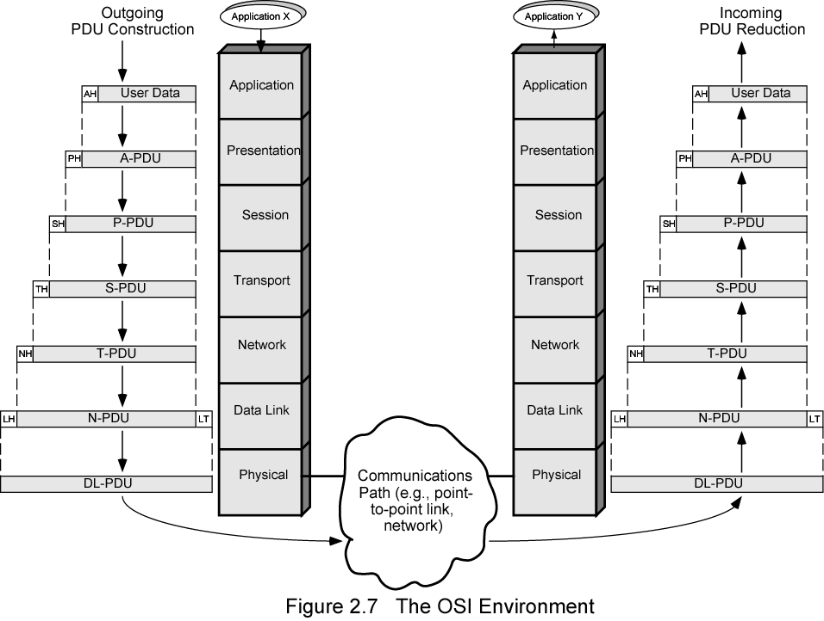
The OSI Environment

Slide 3
Terminology (1)
Transmitter
Receiver
Medium
  Guided medium
    e.g. twisted pair, optical fiber
  Unguided medium
    e.g. air, water, vacuum

Slide 4
Terminology (2)
Simplex
  One direction
    e.g. Television
Half duplex
  Either direction, but only one way at a time
    e.g. police radio
Full duplex
  Both directions at the same time
    e.g. telephone

Slide 5
Frequency, Spectrum and Bandwidth
Time domain concepts
  Analog signal
    Various in a smooth way over time
  Digital signal
    Maintains a constant level then changes to another constant level

Slide 6
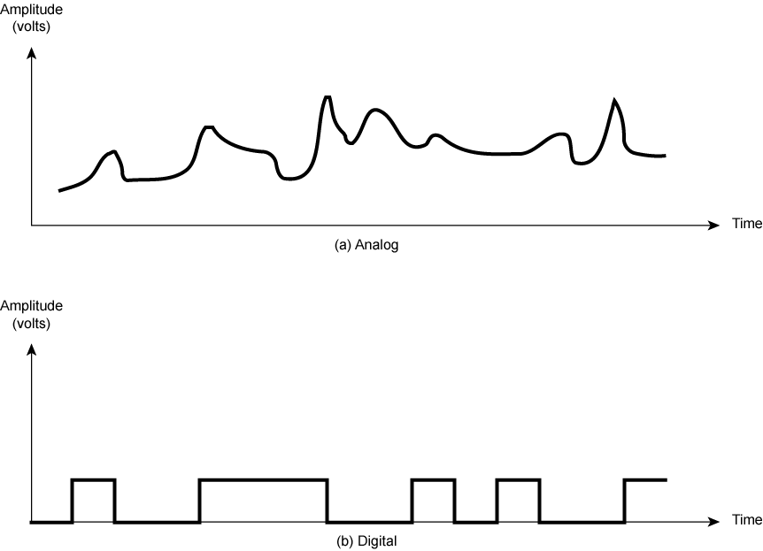
Analogue & Digital Signals

Slide 7
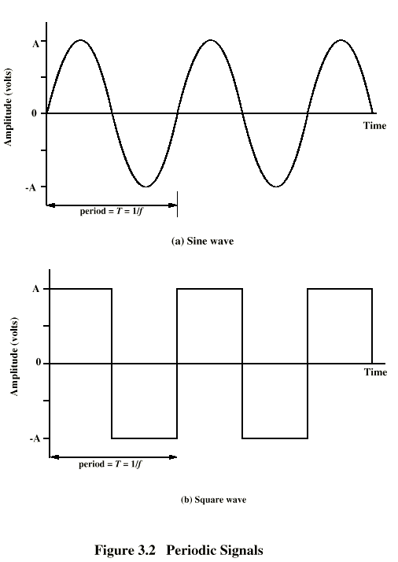
Periodic
Signals

Slide 8
Wavelength
Distance occupied by one cycle
Distance between two points of corresponding phase in two consecutive cycles
λ
Assuming signal velocity v
  λ = vT
  λf = v
  c = 3*10⁸ ms⁻¹ (speed of light in free space)

Slide 9
Spectrum & Bandwidth
Spectrum
  range of frequencies contained in signal
Absolute bandwidth
  width of spectrum
Effective bandwidth
  Often just bandwidth
  Narrow band of frequencies containing most of the energy

Slide 10
Data Rate and Bandwidth
Any transmission system has a limited band of frequencies
This limits the data rate that can be carried

Slide 11
Analog and Digital Data Transmission
Data
  Entities that convey meaning
Signals
  Electric or electromagnetic representations of data
Transmission
  Communication of data by propagation and processing of signals

Slide 12
Analog and Digital Data
Analog
  Continuous values within some interval
  e.g. sound, video
Digital
  Discrete values
  e.g. text, integers

Slide 13
Analog and Digital Signals
Means by which data are propagated
Analog
  Continuously variable
  Various media
    wire, fiber optic, space
  Speech bandwidth 100Hz to 7kHz
  Telephone bandwidth 300Hz to 3400Hz
  Video bandwidth 4MHz

Slide 14
Advantages & Disadvantages of Digital
Cheaper
Less susceptible to noise
Greater attenuation
  Pulses become rounded and smaller
  Leads to loss of information

Slide 15
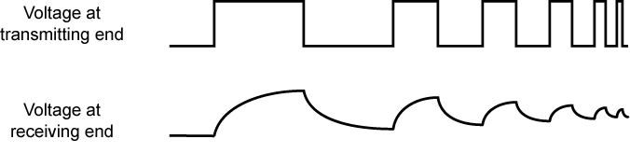
Attenuation of Digital Signals

Slide 16
Data and Signals
Usually use digital signals for digital data and analog signals for analog data
Can use analog signal to carry digital data
  Modem
Can use digital signal to carry analog data
  Compact Disc audio

Slide 17
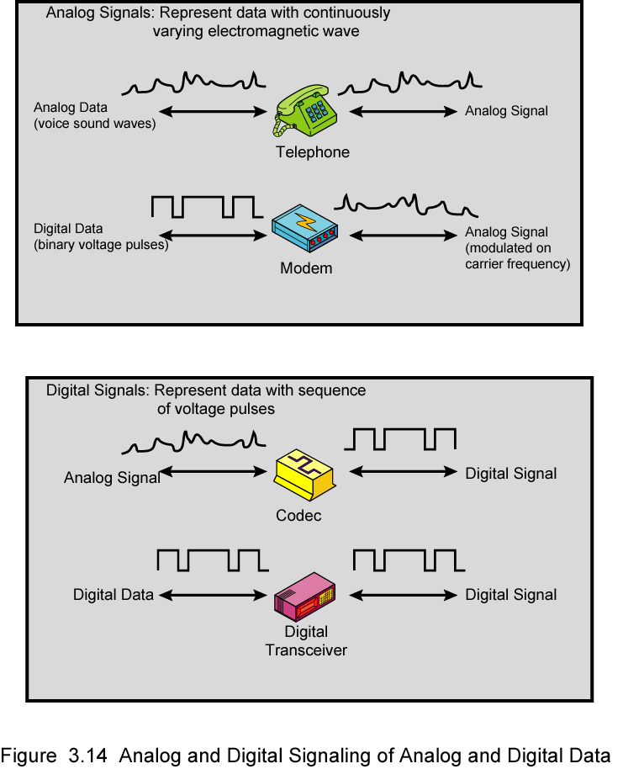
Analog Signals Carrying Analog and Digital Data

Slide 18
Digital Signals Carrying Analog and Digital Data

Slide 19
Analog Transmission
Analog signal transmitted without regard to content
May be analog or digital data
Attenuated over distance
Use amplifiers to boost signal
Also amplifies noise

Slide 20
Digital Transmission
Concerned with content
Integrity endangered by noise, attenuation etc.
Repeaters used
Repeater receives signal
Extracts bit pattern
Retransmits
Attenuation is overcome
Noise is not amplified

Slide 21
Advantages of Digital Transmission
Digital technology
  Low cost
Data integrity
  Longer distances over lower quality lines
Capacity utilization
  High bandwidth links economical
  High degree of multiplexing easier with digital techniques
Security & Privacy
  Encryption
Integration
  Can treat analog and digital data similarly

Slide 22
Transmission Impairments
Signal received may differ from signal transmitted
Analog - degradation of signal quality
Digital - bit errors
Caused by
  Attenuation and attenuation distortion
  Delay distortion
  Noise

Slide 23
Attenuation
Signal strength falls off with distance
Depends on medium
Received signal strength:
  must be enough to be detected
  must be sufficiently higher than noise to be received without error
Attenuation is an increasing function of frequency

Slide 24
Delay Distortion
Only in guided media
Propagation velocity varies with frequency

Slide 25
Noise (1)
Additional signals inserted between transmitter and receiver
Thermal
  Due to thermal agitation of electrons
  Uniformly distributed
  White noise
Intermodulation
  Signals that are the sum and difference of original frequencies sharing a medium

Slide 26
Noise (2)
Crosstalk
  A signal from one line is picked up by another
Impulse
  Irregular pulses or spikes
  e.g. External electromagnetic interference
  Short duration
  High amplitude

Slide 27
Channel Capacity
Data rate
  In bits per second
  Rate at which data can be communicated
Bandwidth
  In cycles per second of Hertz
  Constrained by transmitter and medium

Slide 28
Nyquist Bandwidth
If rate of signal transmission is 2B then signal with frequencies no greater than B is sufficient to carry signal rate
Given bandwidth B, highest signal rate is 2B
Given binary signal, data rate supported by B Hz is 2B bps
Can be increased by using M signal levels
C= 2B log₂M

Slide 29
Shannon Capacity Formula
Consider data rate,noise and error rate
Faster data rate shortens each bit so burst of noise affects more bits
  At given noise level, high data rate means higher error rate
Signal to noise ratio (in decibels)
SNR_{db}⁼10 log₁₀ (signal/noise)
Capacity C=B log₂(1+SNR)

Slide 30

Shannon Capacity Formula
Notes:
S1-N1=S2-(2*N1)
N2 becomes (2*N1) because question said noise power at output is twice as much as input.
Step 2 :
S1-N1=(S1-10)-(2*N1)
S2 now becomes (S1-10) because question also said there is attenuation of the channel which is 10dB, and it also says "The channel does not attenuate the noise", which means that it only attenuate signal power instead. So I subtract 10 from S1 and set it to S2.
Step 3 :
Then I get N1=-10, then we know N2=-20 (because Question said N2 is twice as N1)
Step 4 :
Now, question want me to determine SNR in DB at output. So, here I used SNR(dB) formula, which is "SNR(dB)=10log(SNR) where base is 10".
10log(-20) = 13.01 dB

